Slide 1
Multiple Linear Regression
While simple linear regression is useful for predicting a response on the basis of a single predictor variable, in practice, we often have more than one predictor.

Slide 2
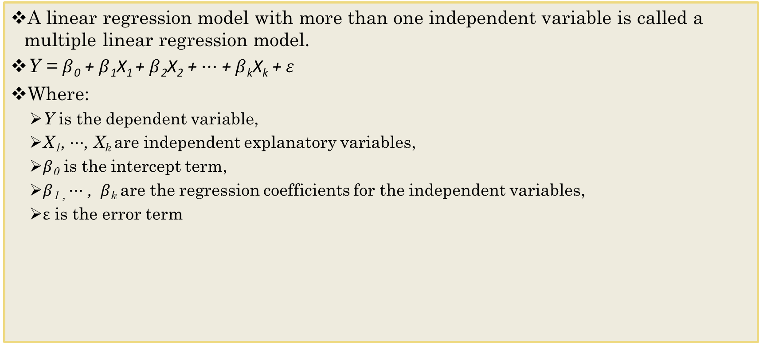
Multiple Linear Regression
A linear regression model with more than one independent variable is called a multiple linear regression model.
Y = $β$₀ + $β$₁X₁ + $β$₂X₂ + $⋯$ + $β$_{k}X_{k}$\text{+} ε$
Where:
Y is the dependent variable,
X₁, $⋯$, X_{k} are independent explanatory variables,
$β$₀ is the intercept term,
$β$_{1 ,} $⋯$ , $β$_{k} are the regression coefficients for the independent variables,
$ε$ is the error term

Slide 3
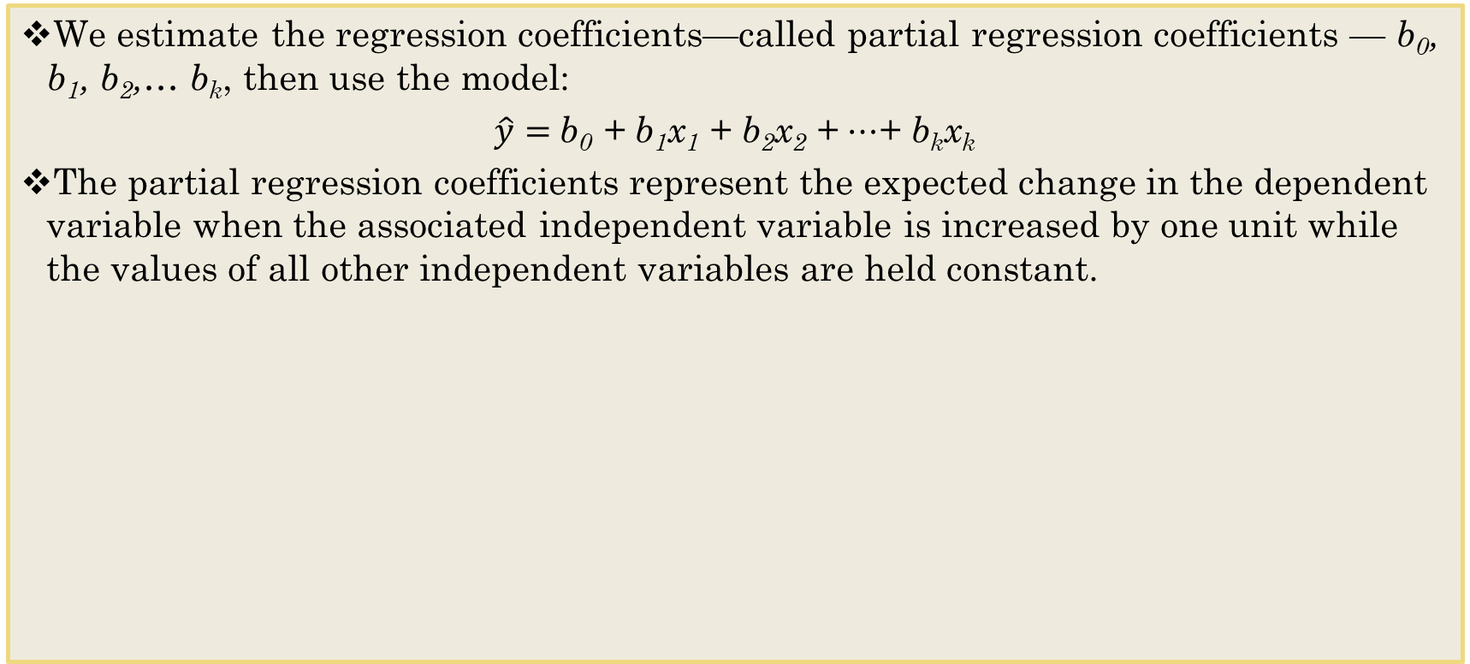
Estimated Multiple Regression Equation
We estimate the regression coefficients—called partial regression coefficients — b₀, b₁, b₂,… b_{k}, then use the model:
$\hat{y}=$ b₀ + b₁x₁ + b₂x₂ + $⋯$+ b_{k}x_{k}
The partial regression coefficients represent the expected change in the dependent variable when the associated independent variable is increased by one unit while the values of all other independent variables are held constant.

Slide 4
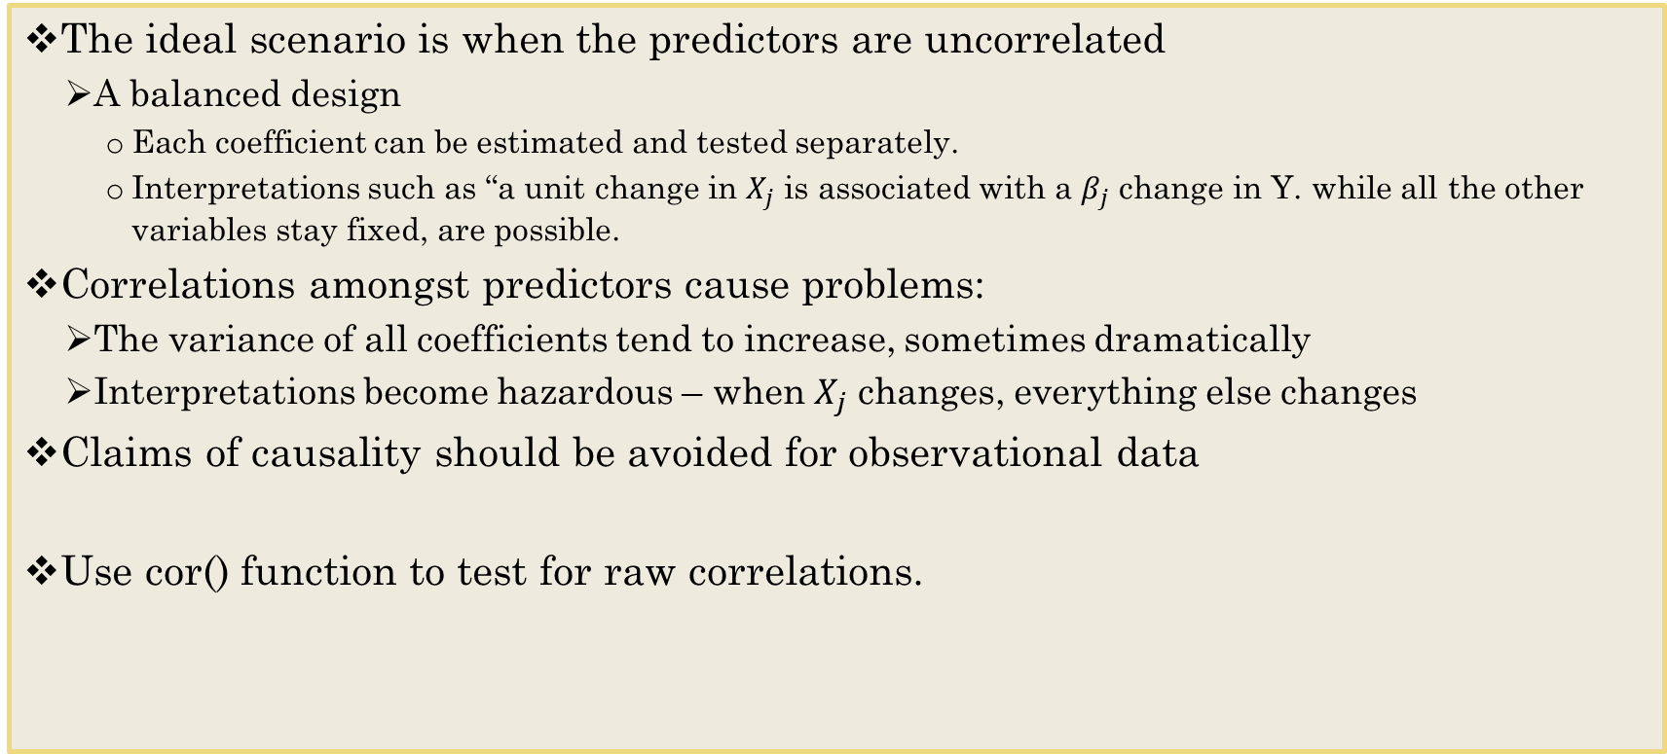
Interpreting regression coefficients
The ideal scenario is when the predictors are uncorrelated
A balanced design
Each coefficient can be estimated and tested separately.
Interpretations such as “a unit change in $X_{j}$ is associated with a $β_{j}$ change in Y. while all the other variables stay fixed, are possible.
Correlations amongst predictors cause problems:
The variance of all coefficients tend to increase, sometimes dramatically
Interpretations become hazardous – when $X_{j}$ changes, everything else changes
Claims of causality should be avoided for observational data
Use cor() function to test for raw correlations.

Slide 5
Some important questions
Is at least one of the predictors useful in predicting a response?
Do all the predictors help to explain Y, or is only a subset of the predictors useful?
Given a set of predictor values, what response value should we predict, and how accurate is our prediction?
How well does the model fit the data?
R^2, adjusted R^2

Slide 6
Is at least one of the predictors useful in predicting a response?
If the p-value associated with the F-statistic is sufficient to reject the null hypothesis, we conclude that at least one of the predictors is related to the response. It is then natural to wonder which one (or ones).
We could look at the individual p-values, but if the number of variables p is large we are likely to make some false discoveries.
The validity of the coefficient p-values are also compromised by the presence of covariance among the regressors.

Slide 7
Deciding on Important Variables
There are several reasons for exercising caution before throwing in all possible variables
It may be expensive or not feasible to collect a full complement of predictors for future predictions.
We may be able to measure fewer predictors more accurately (e.g., in surveys).
The more predictors, the higher the chance of missing values in the data. If we delete or impute records with missing values, multiple predictors will lead to a higher rate of record deletion or imputation.
Parsimony is an important property of good models. We obtain more insight into the influence of predictors in models with few parameters.
Estimates of regression coefficients are likely to be unstable, due to multicollinearity in models with many variables. (Multicollinearity is the presence of two or more predictors sharing the same linear relationship with the outcome variable.) Regression coefficients are more stable for parsimonious models. One very rough rule of thumb is to have a number of records n larger than 5(p + 2), where p is the number of predictors.
It can be shown that using predictors that are uncorrelated with the outcome variable increases the variance of predictions.
It can be shown that dropping predictors that are actually correlated with the outcome variable can increase the average error (bias) of predictions.
Notes:
Social desirability bias

Slide 8
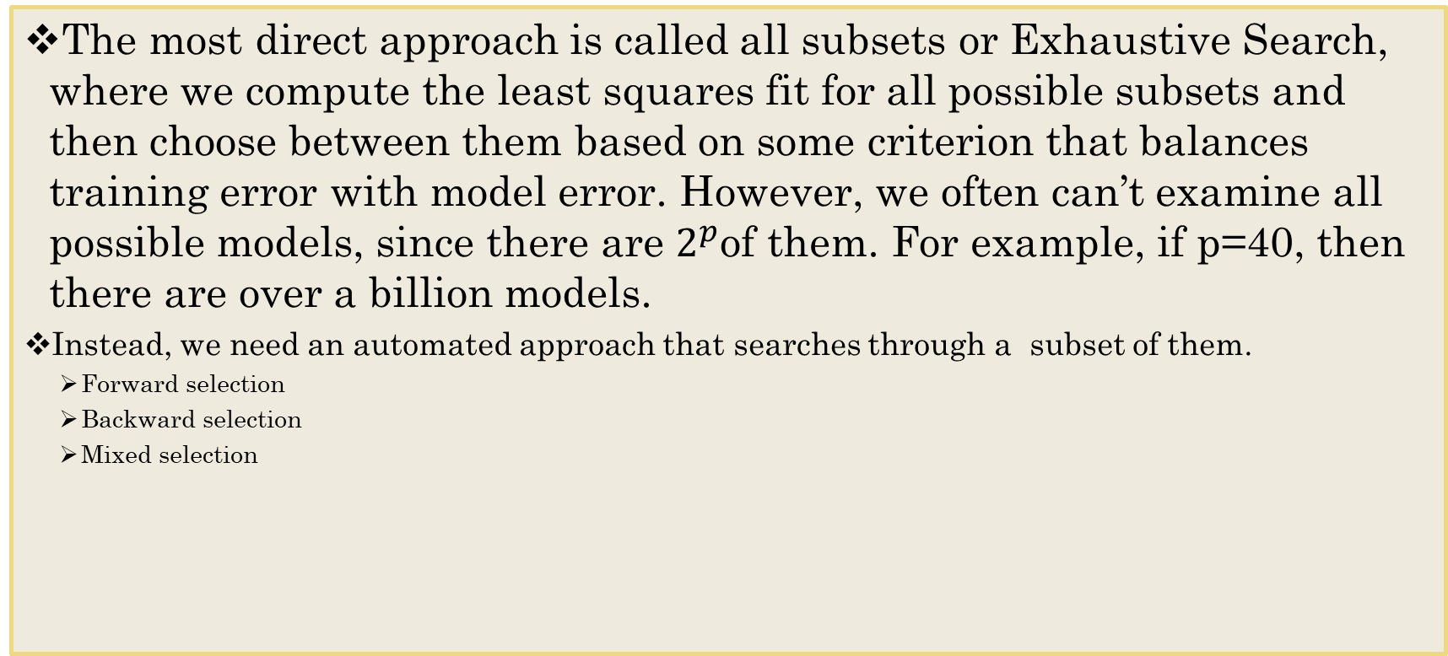
Exhaustive Search
The most direct approach is called all subsets or Exhaustive Search, where we compute the least squares fit for all possible subsets and then choose between them based on some criterion that balances training error with model error. However, we often can’t examine all possible models, since there are $2^{p}$of them. For example, if p=40, then there are over a billion models.
Instead, we need an automated approach that searches through a subset of them.
Forward selection
Backward selection
Mixed selection

Slide 9
Forward Selection
Begin with the null model – a model that contains an intercept, but no predictors.
Fit p simple linear regressions and add to the null model the variable that results in the lowest Sum of Squares Regression.
Add to the model the variable that results in the lowest Sum of Squares Regression amongst all two variable models.
Continue until some stopping rule is satisfied, for example, when all remaining variables have a p-value above some threshold.

Slide 10
Backward Selection
Start with all variables in the model.
Remove the variable with the largest p-value – that is the variable that is the least statistically significant.
The new (p-1) variable model is fit, and the new variable with the largest p-value is removed.
Continue until some stopping rule is reached. For instance, when all remaining variables have significant p-values defined by some significance threshold.

Slide 11
Mixed Selection
This is a combination of forward and backward selection.
We start with no variables in the model, we add the variable that provides the best fit.
We continue one-by-one.
If at any point the p-value for one variables in the model rises above a certain threshold, then we remove that variable from the model.
We continue to perform these forward and backward steps until all variables in the model have a sufficiently low p-value, and all the variables outside the model would have a large p-value.

Slide 12
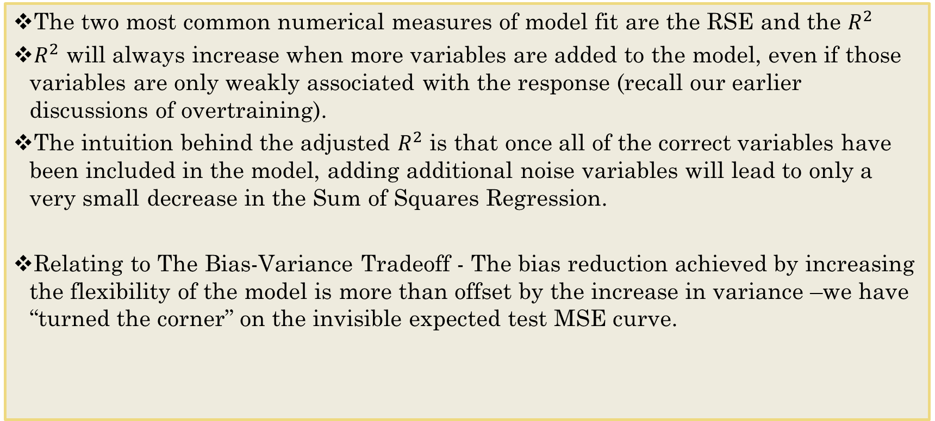
Model Fit
The two most common numerical measures of model fit are the RSE and the $R^{2}$
$R^{2}$ will always increase when more variables are added to the model, even if those variables are only weakly associated with the response (recall our earlier discussions of overtraining).
The intuition behind the adjusted $R^{2}$ is that once all of the correct variables have been included in the model, adding additional noise variables will lead to only a very small decrease in the Sum of Squares Regression.
Relating to The Bias-Variance Tradeoff - The bias reduction achieved by increasing the flexibility of the model is more than offset by the increase in variance –we have “turned the corner” on the invisible expected test MSE curve.

Slide 13
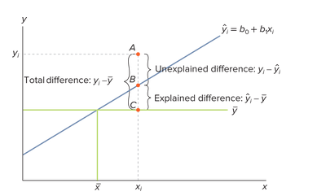
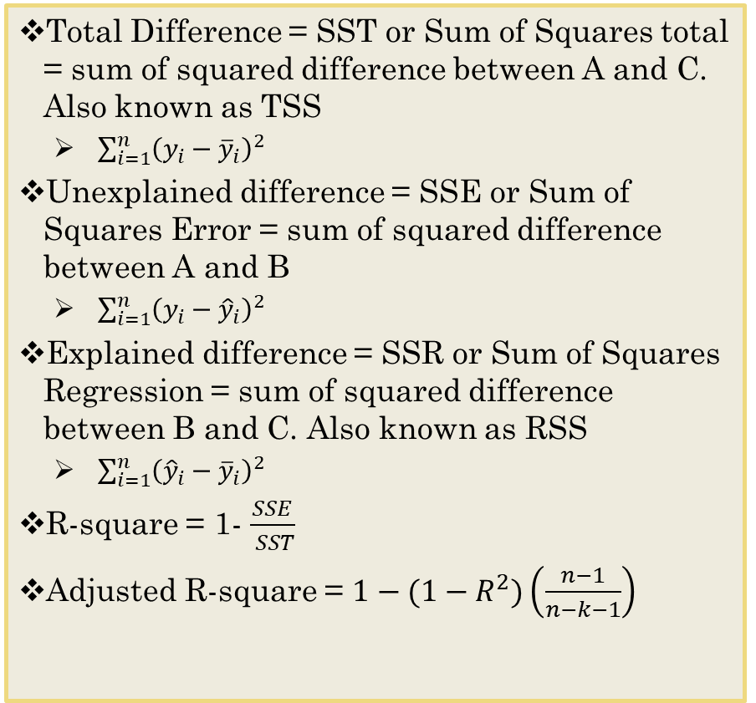
Some Notations
SSR = Sum of Squares [due to] Regression
SSE = Sum of Squares [due to] Error
SST= Total Sum of Squares
Total Difference = SST or Sum of Squares total = sum of squared difference between A and C. Also known as TSS
$\sum_{i=1}^{n}{{\left(y_{i}−{\overline{y}}_{i}\right)}^{2}}$
Unexplained difference = SSE or Sum of Squares Error = sum of squared difference between A and B
$\sum_{i=1}^{n}{{\left(y_{i}−{\hat{y}}_{i}\right)}^{2}}$
Explained difference = SSR or Sum of Squares Regression = sum of squared difference between B and C. Also known as RSS
$\sum_{i=1}^{n}{{\left({\hat{y}}_{i}−{\overline{y}}_{i}\right)}^{2}}$
R-square = 1- $\frac{SSE}{ SST}$
Adjusted R-square = $1−(1−R^{2})\left(\frac{n−1}{n−k−1}\right)$
Notes:
Naïve bayes: predicted at the mean
n – sample size, k - # of predictors

Slide 14
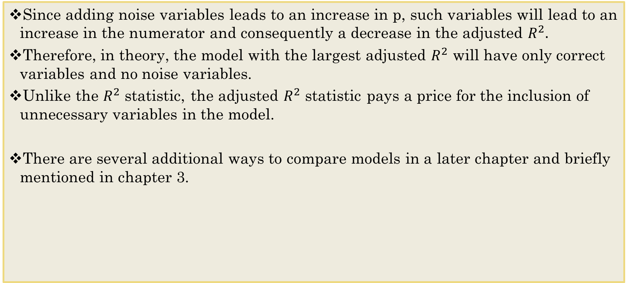
Model Fit
Since adding noise variables leads to an increase in p, such variables will lead to an increase in the numerator and consequently a decrease in the adjusted $R^{2}.$
Therefore, in theory, the model with the largest adjusted $R^{2}$ will have only correct variables and no noise variables.
Unlike the $R^{2}$ statistic, the adjusted $R^{2}$ statistic pays a price for the inclusion of unnecessary variables in the model.
There are several additional ways to compare models in a later chapter and briefly mentioned in chapter 3.
Notes:
Noise variables: when adding the variables doesn’t help improve the model

Slide 15
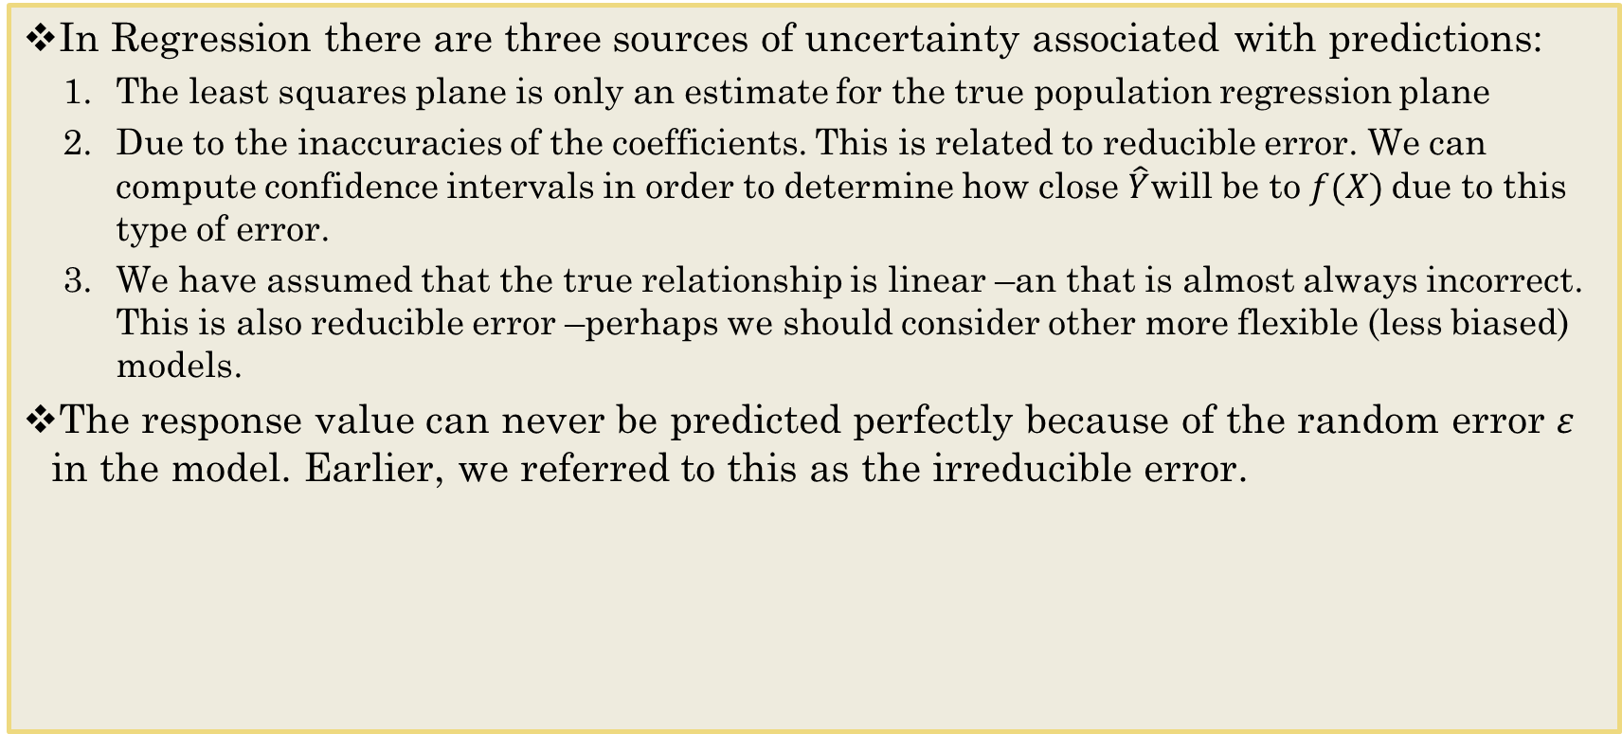
Predictions
In Regression there are three sources of uncertainty associated with predictions:
The least squares plane is only an estimate for the true population regression plane
Due to the inaccuracies of the coefficients. This is related to reducible error. We can compute confidence intervals in order to determine how close $\hat{Y}$will be to $f(X)$due to this type of error.
We have assumed that the true relationship is linear –an that is almost always incorrect. This is also reducible error –perhaps we should consider other more flexible (less biased) models.
The response value can never be predicted perfectly because of the random error $ε$ in the model. Earlier, we referred to this as the irreducible error.

Slide 16
Confidence Intervals
We can use confidence interval to quantify the uncertainty surrounding the problem.
Confidence Intervals are estimates that are calculated from sample data to determine ranges likely to contain the population parameter of interest. Parameters are mean and standard deviation.
A 95% confidence level means that out of 100 random samples taken, we expect 95 of the confidence intervals to contain the true population parameter.

Slide 17
Other Model Considerations
Collinearity refers to the situation in which two or more predictor variables are closely related to another.
Variation Inflation Factor assesses Multicollinearity, in which it is possible for collinearity to exist between three or more variables even if no pair of variables has a particularly high correlation
Can measure through VIF, which is part of the car package.
As a rule of thumb, a VIF value that exceeds 5 or 10 indicates a problematic amount of collinearity.

